Slide 1
MATHEMATICAL FOUNDATION FOR COMPUTER SCIENCE
Prepared by: Er. Ankit Kharel
Nepal college of information technology

Slide 2
Finite state automata
• Sequential Circuits and Finite state Machine
• Finite State Automata
• Non-deterministic Finite State Automata
• Language and Grammars
• Language and Automata
• Regular Expression

Slide 3
Language and grammar
Merriam-Webster’s Dictionary describes language as “the words, their pronunciation, and the methods of combining them used and understood by a community” .
But this description of language is for natural languages • The rules of natural languages are very complex and difficult to characterize completely.
Hence, comes the Formal language .
Formal languages are used to model natural languages and to communicate with the computers .
As it is possible to specify completely the rules by which certain formal languages are constructed .

Slide 4
Language and grammar
Let A be a finite set of alphabets.
A (formal) language L over A is a subset of A∗, the set of all strings over A.
For example: Let A = {a, b}. The set L of all strings over A containing an odd number of a’s is a language over A.
One way to define a language is to give a list of rules that the language is assumed to obey(GRAMMAR)

Slide 5
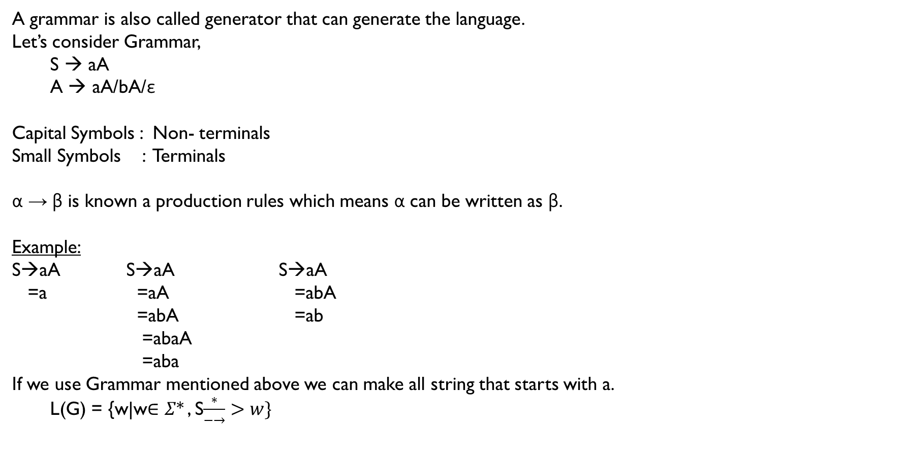
grammar
A grammar is also called generator that can generate the language.
Let’s consider Grammar,
S → aA
A → aA/bA/ε
Capital Symbols : Non- terminals
Small Symbols : Terminals
α → β is known a production rules which means α can be written as β.
Example:
S→aA S→aA S→aA
=a =aA =abA
=abA =ab
=abaA
=aba
If we use Grammar mentioned above we can make all string that starts with a.
L(G) = {w|w$∈Σ∗$ , S$\frac{∗}{−→}>w\}$

Slide 6
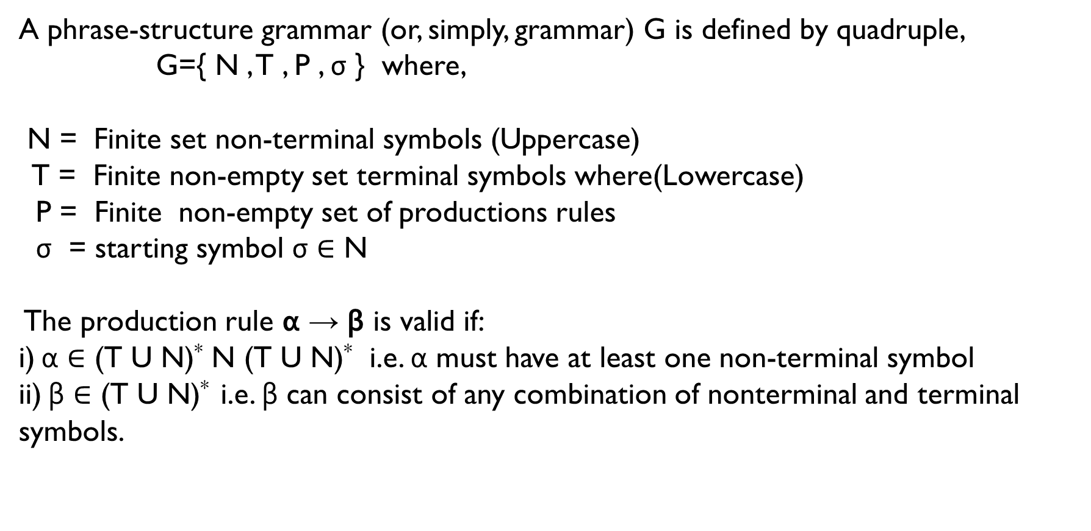
Formal definition of grammar:
A phrase-structure grammar (or, simply, grammar) G is defined by quadruple,
G={ N , T , P , σ } where,
N = Finite set non-terminal symbols (Uppercase)
T = Finite non-empty set terminal symbols where(Lowercase)
P = Finite non-empty set of productions rules
σ = starting symbol σ ∈ N
The production rule α → β is valid if:
i) α $∈$ (T U N)* N (T U N)* i.e. α must have at least one non-terminal symbol
ii) β $∈$ (T U N)* i.e. β can consist of any combination of nonterminal and terminal symbols.

Slide 7
Chomsky hierarchy:
Chomsky Hierarchy is a brand classification of the various types of grammar available. Grammars are classified by the form of their production category represents a class of languages that can be recognized by different automata.
Type-0
REL
Turing machine
Type-1
CSL
LBA
Type-2
CFL
PDA
Type-3
RL
FA
GRAMMAR
LANGUAGE
AUTOMATA

Slide 8
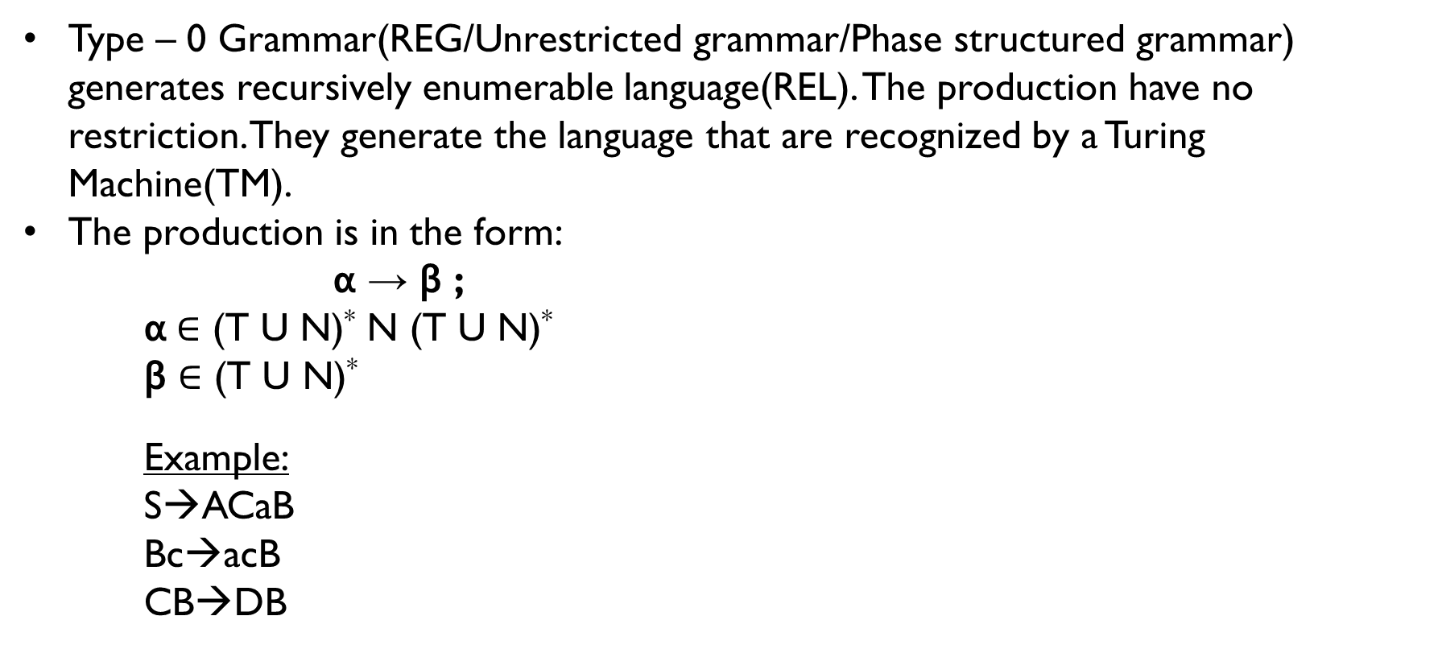
TYPe-0 (Recursive Enumerable Grammar):
Type – 0 Grammar(REG/Unrestricted grammar/Phase structured grammar) generates recursively enumerable language(REL). The production have no restriction. They generate the language that are recognized by a Turing Machine(TM).
The production is in the form:
α → β ;
α$∈$ (T U N)* N (T U N)*
β $∈$ (T U N)*
Example:
S→ACaB
Bc→acB
CB→DB
REG
REL
TM

Slide 9
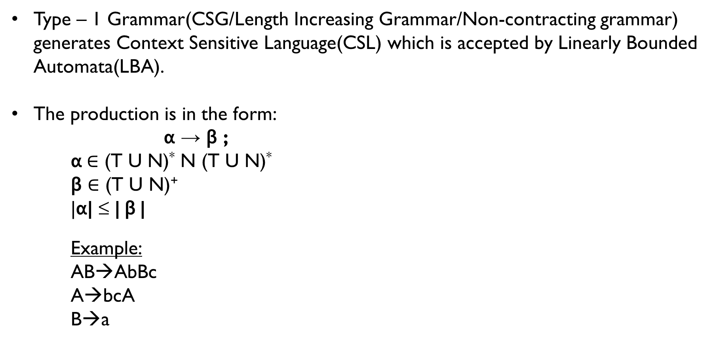
TYPe-1 (Context Sensitive Grammar):
Type – 1 Grammar(CSG/Length Increasing Grammar/Non-contracting grammar) generates Context Sensitive Language(CSL) which is accepted by Linearly Bounded Automata(LBA).
The production is in the form:
α → β ;
α$∈$ (T U N)* N (T U N)*
β $∈$ (T U N)⁺
|α| ≤ | β |
Example:
AB→AbBc
A→bcA
B→a
CSG
CSL
LBA

Slide 10
Exception:
S → ε
S should be a start symbol but should not appear in RHS of production.
Example:
S→aSb S→AB
S→ ε S→ ε
αAβ → α ∂ β
where α , β ∊ (N∪T)* , A ∊ N and ∂ ∊ (N∪T)⁺ - the grammar is called context sensitive grammar.
Example:
aAb→aBb
cAd→cCd
Not allowed
Allowed
Left Context
Right Context

Slide 11
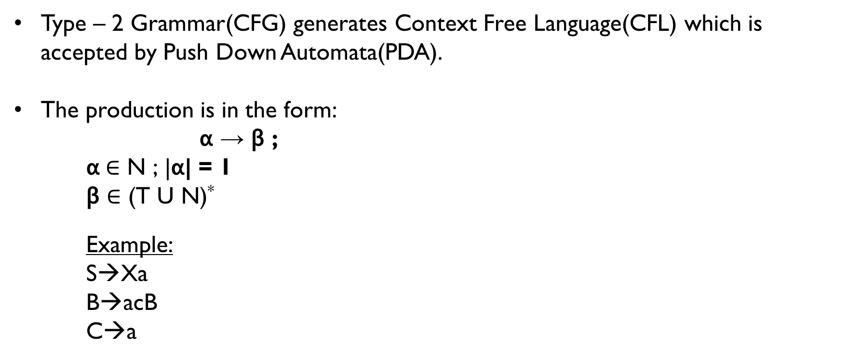
TYPe-2 (Context FREE Grammar):
Type – 2 Grammar(CFG) generates Context Free Language(CFL) which is accepted by Push Down Automata(PDA).
The production is in the form:
α → β ;
α$∈$ N ; |α| = 1
β $∈$ (T U N)*
Example:
S→Xa
B→acB
C→a
CFG
CFL
PDA

Slide 12
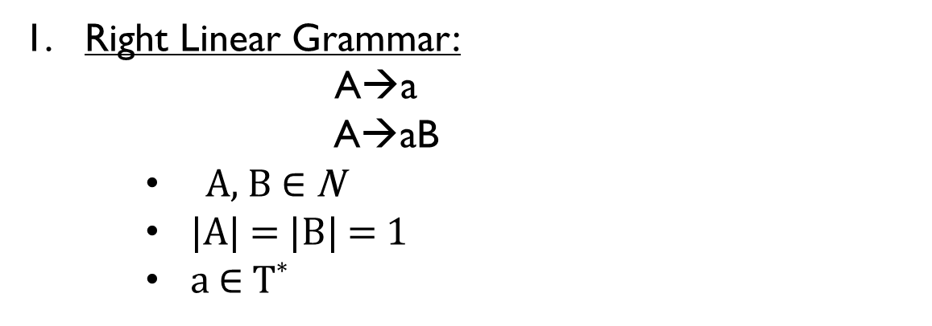
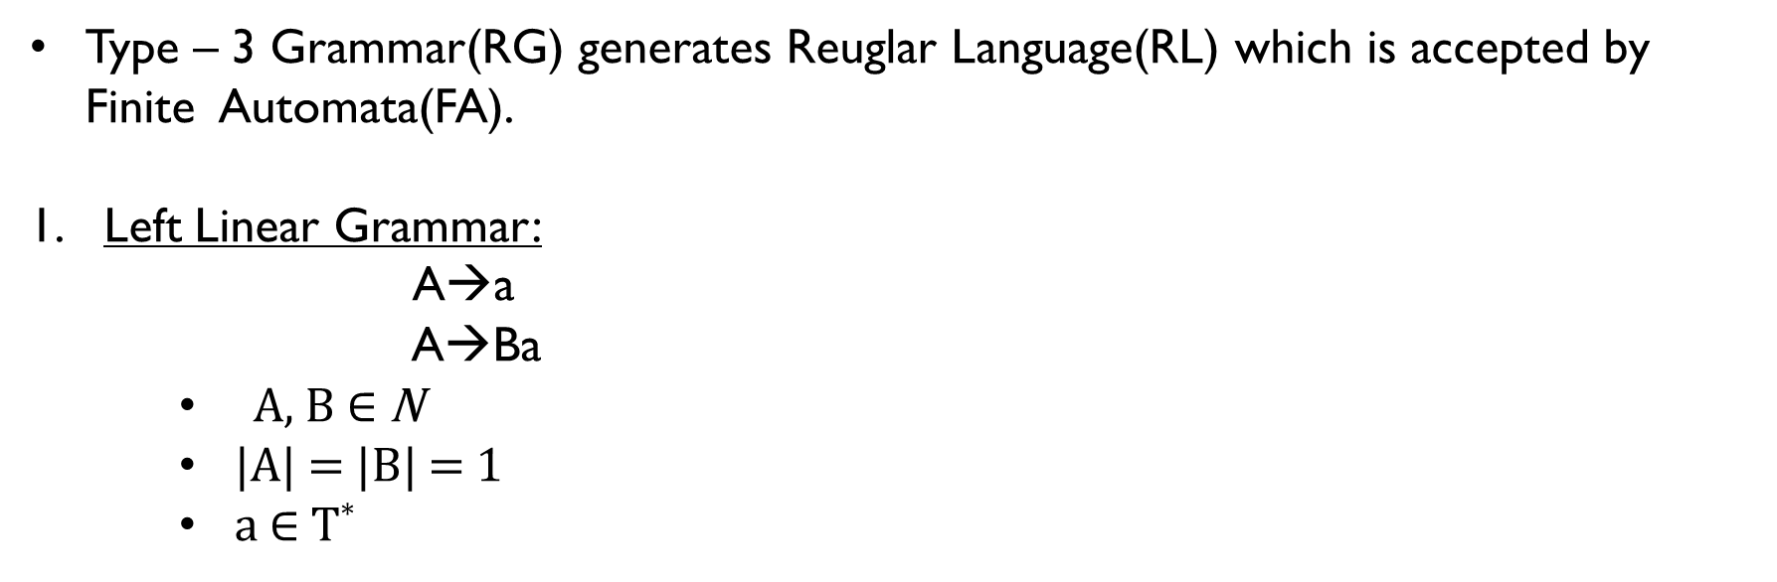
TYPe-3 (Regular Grammar):
Type – 3 Grammar(RG) generates Reuglar Language(RL) which is accepted by Finite Automata(FA).
Left Linear Grammar:
A→a
A→Ba
A, B $∈$ N
|A| = |B| = 1
a $∈$ T*
RG
Example:
A→abc
A→aBa(invalid)
A→Ca
RL
FA
Right Linear Grammar:
A→a
A→aB
A, B $∈$ N
|A| = |B| = 1
a $∈$ T*
Example:
A→a
A→aBa(invalid)
A→Ca(invalid)
A→aC

Slide 13
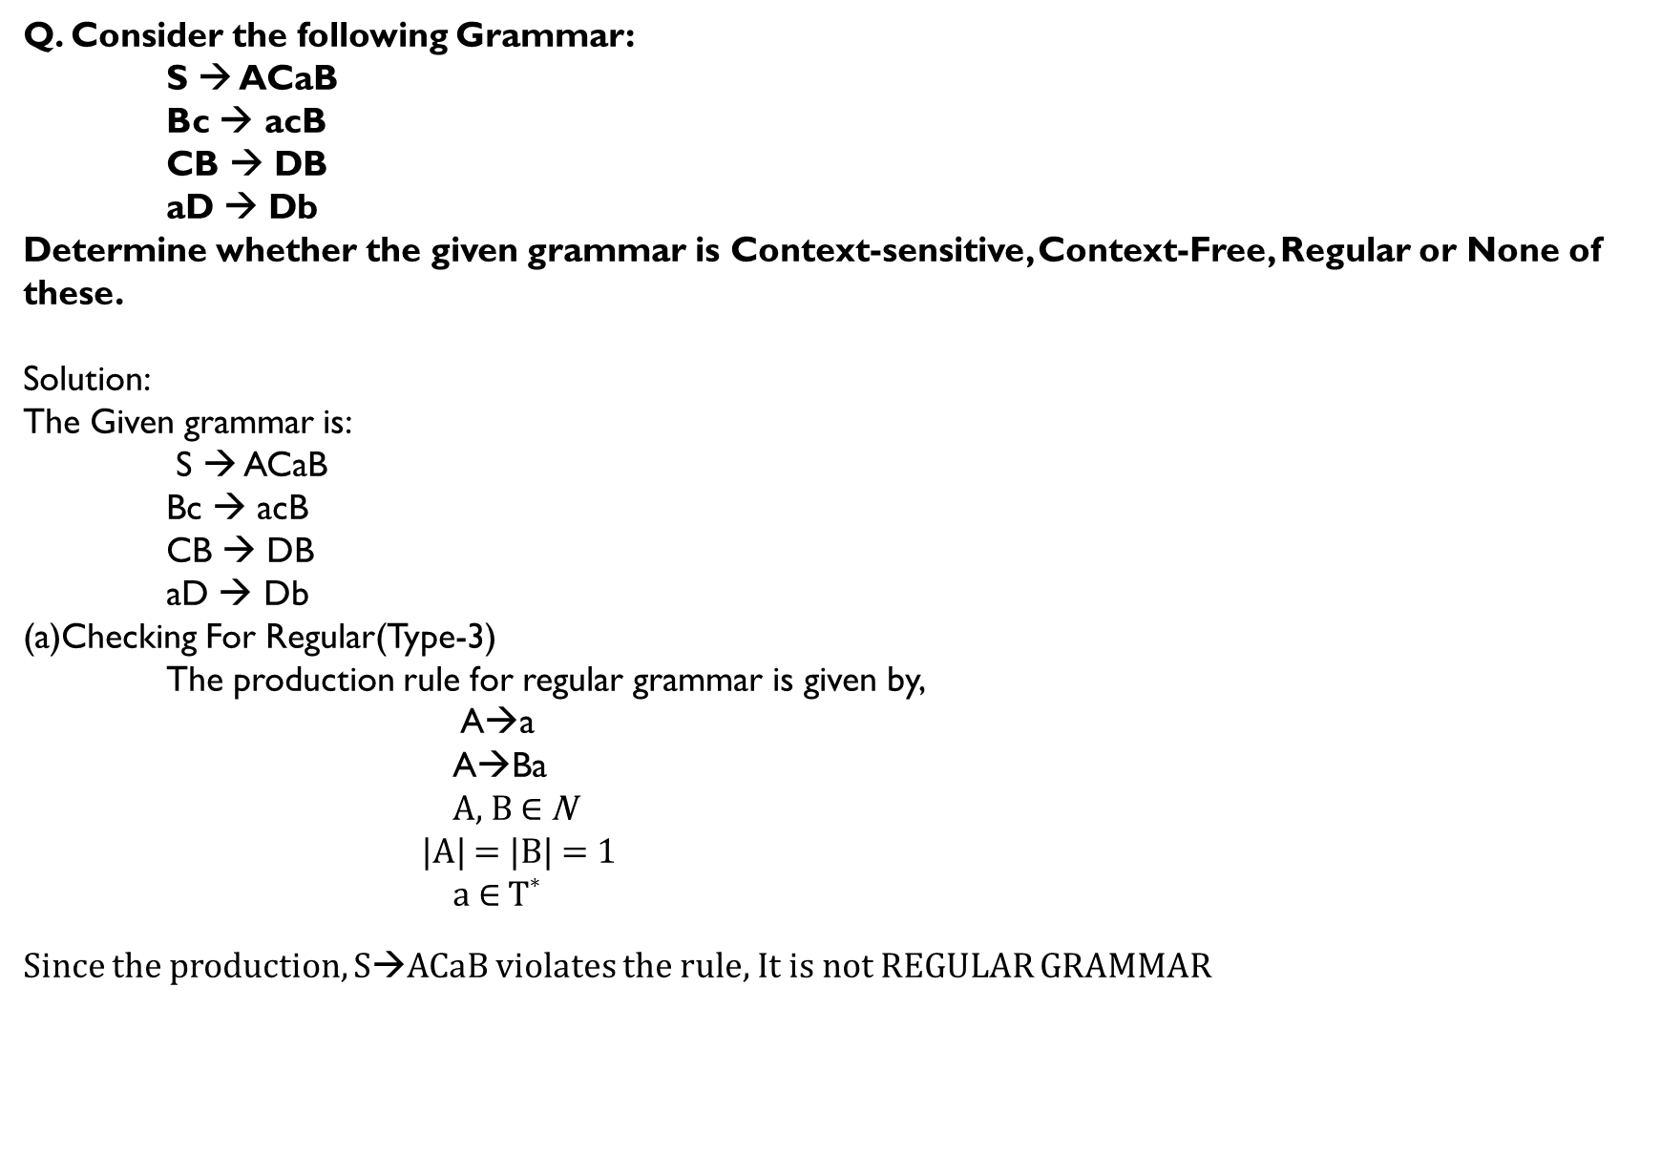
Q. Consider the following Grammar:
S → ACaB
Bc → acB
CB → DB
aD → Db
Determine whether the given grammar is Context-sensitive, Context-Free, Regular or None of these.
Solution:
The Given grammar is:
S → ACaB
Bc → acB
CB → DB
aD → Db
(a)Checking For Regular(Type-3)
The production rule for regular grammar is given by,
A→a
A→Ba
A, B $∈$ N
|A| = |B| = 1
a $∈$ T*
Since the production, S→ACaB violates the rule, It is not REGULAR GRAMMAR

Slide 14
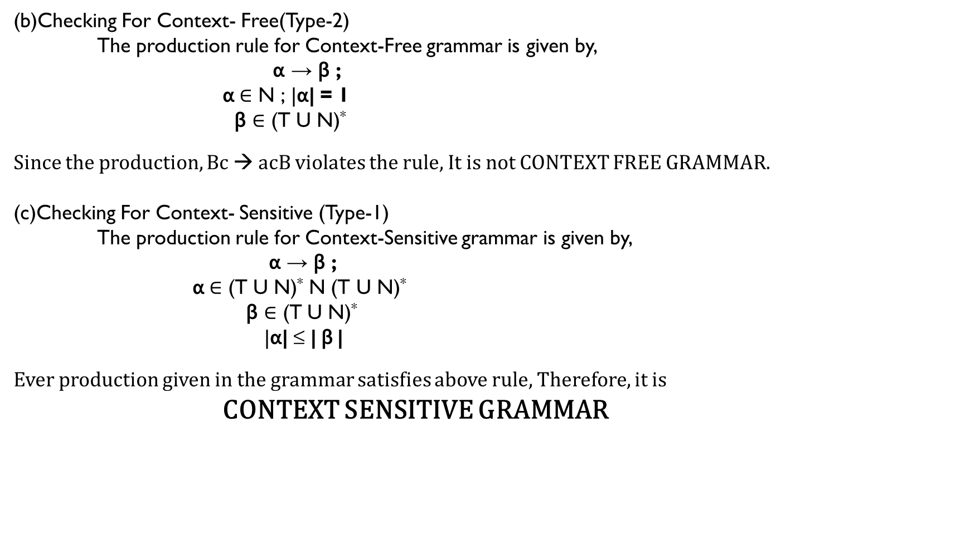
(b)Checking For Context- Free(Type-2)
The production rule for Context-Free grammar is given by,
α → β ;
α$∈$ N ; |α| = 1
β $∈$ (T U N)*
Since the production, Bc → acB violates the rule, It is not CONTEXT FREE GRAMMAR.
(c)Checking For Context- Sensitive (Type-1)
The production rule for Context-Sensitive grammar is given by,
α → β ;
α$∈$ (T U N)* N (T U N)*
β $∈$ (T U N)*
|α| ≤ | β |
Ever production given in the grammar satisfies above rule, Therefore, it is
CONTEXT SENSITIVE GRAMMAR

Slide 15
Derivation tree for CFG:
A derivation Tree or Parse Tree is an ordered rooted tree that graphically represents the semantic information of string derived from a Context Free Grammar.
Consider the following grammar:
G={ N , T , P , σ } where Production rule is given by:
S→0B
A→1AA/ ε
B→0AA
Construct Derivation Tree for the string “001”
S→0B
00AA
001AAA
001
Root Vertex : Must be labelled by start symbol
Vertex : Labelled by Non- Terminal symbols
Leaves : Labelled by Terminal Symbols
S
0
B
0
A
A
1
A
A
ε
ε
ε

Slide 16
Derivation tree for CFG:
LEFTMOST DERIVATION:
A leftmost Derivation Tree is obtained by applying production function to the leftmost variable in each step.
Consider the following grammar:
G={ N , T , P , σ } where Production rule is given by:
S→aAS/aSS/e
A→SbA/ba
Construct Derivation Tree for the string “aabaa”
S→aSS
aaASS
aabaSS
aabaaSSS
aabaa
S
a
S
S
ε
a
A
S
b
a
a
S
S
ε
ε

Slide 17
Derivation tree for CFG:
2. RIGHTMOST DERIVATION:
A rightmost Derivation Tree is obtained by applying production function to the rightmost variable in each step.
Consider the following grammar:
G={ N , T , P , σ } where Production rule is given by:
S→aAS/aSS/e
A→SbA/ba
Construct Derivation Tree for the string “aabaa”
S→aSS
aSaAS
aSaAaSS
aSaAa
aSabaa
aabaa
S
a
S
S
ε
a
A
S
b
a
a
S
S
ε
ε

Slide 18
Derivation tree for CFG:
S
G={ N , T , P , σ } where Production rule is given by:
S→aB/bA
A→a/aS/bAA
B→b/bS/aBB
Construct left Derivation Tree for the string “aabbabba”
S→aB
aaBB
aabSB
aabbAB
aabbaB
aabbabS
aabbabbA
aabbabba
a
B
a
B
B
b
S
b
S
b
A
b
A
a
a

Slide 19
Derivation tree for CFG:
S
G={ N , T , P , σ } where Production rule is given by:
S→aB/bA
A→a/aS/bAA
B→b/bS/aBB
Construct right Derivation Tree for the string “aabbabba”
S→aB
aaBB
aaBbS
aaBbbA
aaBbba
aabSbba
aabbAbba
aabbabba
a
B
a
B
B
b
S
b
S
b
A
b
A
a
a

Slide 20
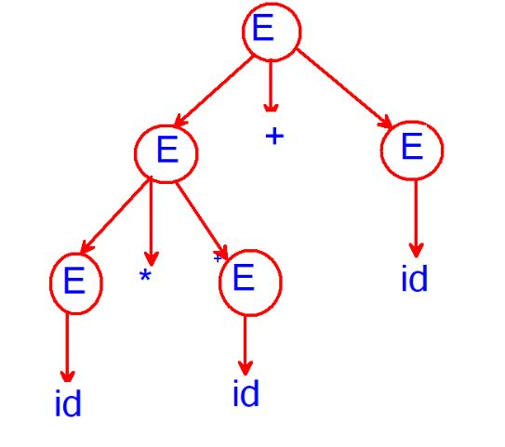
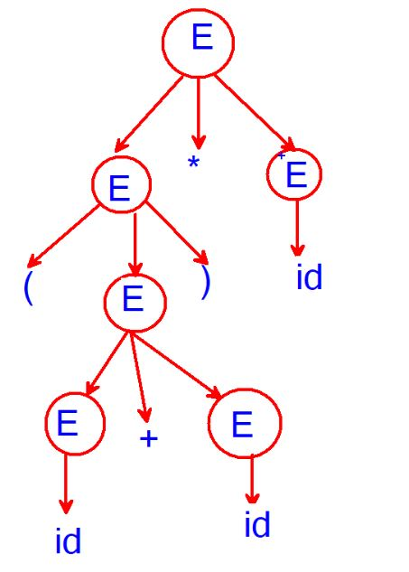
Derivation tree for CFG:
Consider the grammar G={ N , T , P , σ } where
Production rule is given by:
E→E + E
E→E * E
E→(E)
E→id
Construct Derivation Tree for the id * id + id
E→E + E
E * E + E
id * id + id
Construct Derivation Tree for the (id + id) * id
E→E * E
(E) * E
(E + E) * E
(id + id) * id

Slide 21
BNF(Backus Normal Form):
An alternative way to state of productions of a grammar is by using Backus Normal Form(BNF). It is meta syntax for CFG.
Syntax:
<LHS> : : = RHS
(Non – terminals) (Terminals)
Example:
<letter> : : = a/b/c/d/e/t/o
<word> : := <letter><letter>
(This generates word consisting of two letter)
<word>
<letter> <letter>
t o

Slide 22
BNF(Backus Normal Form):
Grammer for integers:
An integer is defined as a string consisting of an optional sign( + or - ) followed by a string of digits(0 though 9)
The following Grammar generates all string:
<digit> : : = 0/1/2/3/4/5/6/7/8/9
<sign> : : = +/-
<unsigned integer> : : = <digit>/<digit><unsigned integer>
<signed integer> : : = <sign><unsigned integer>
<integer> : : = <signed integer>/<unsigned integer>
Derive integer -102 using above grammar and construct derivation tree.

Slide 23
BNF(Backus Normal Form):
integer
<digit> : : = 0/1/2/3/4/5/6/7/8/9
<sign> : : = +/-
<unsigned integer> : : = <digit>/<digit><unsigned integer>
<signed integer> : : = <sign><unsigned integer>
<integer> : : = <signed integer>/<unsigned integer>
<integer> : : = <signed integer>
<sign><unsigned integer>
-<digit><unsigned integer>
-1<digit><unsigned integer>
-10<digit>
-102
Signed integer
Sign
unsigned integer
-
Digit
unsigned integer
1
Digit
unsigned integer
0
Digit
2

